Slide 1
BUSINESS ANALYTICS & DATA MINING CHAMPIONSHIP 2019
BADM_1002
Varan Singh Rohila
Aryan Khandal
Palak Sood

Slide 2
Contents
Objective
Dataset Provided
Data Preprocessing
Data Analysis
Approach and Building of the Model
Conclusion

Slide 3
Objective
A renowned energy corporation approached our firm with the following requirements:
Since it is crucial to match supply with demand, what pattern or schedule they should adopt for their energy/power purchases?
What are the estimated energy consumption rates of their consumers for the upcoming years (long-term forecast)?
Hence, our case objective defined is “Energy Demand Forecasting for Power Industry”

Slide 4
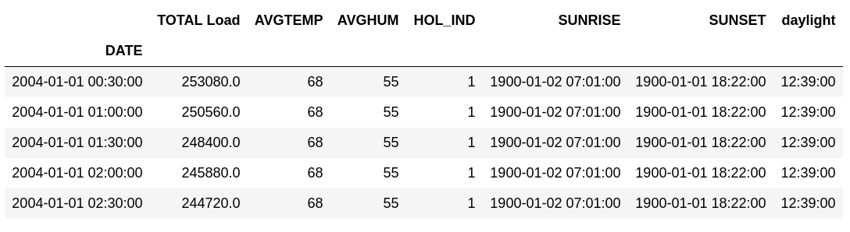
Dataset Provided

Slide 5
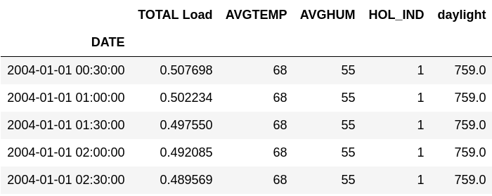
Data Preprocessing

Slide 6
Data Analysis
After the required preprocessing, EDA was used to generalize the data. Various trends in the provided data were observed and some conclusions were drawn as follow:
Drops in power consumption are observed usually when there is a holiday.
There is a decreasing and increasing trend at the end of every year which probably indicates a season change.

Slide 7
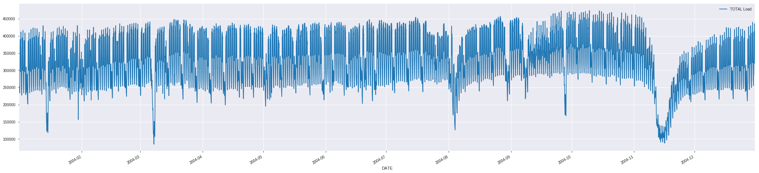
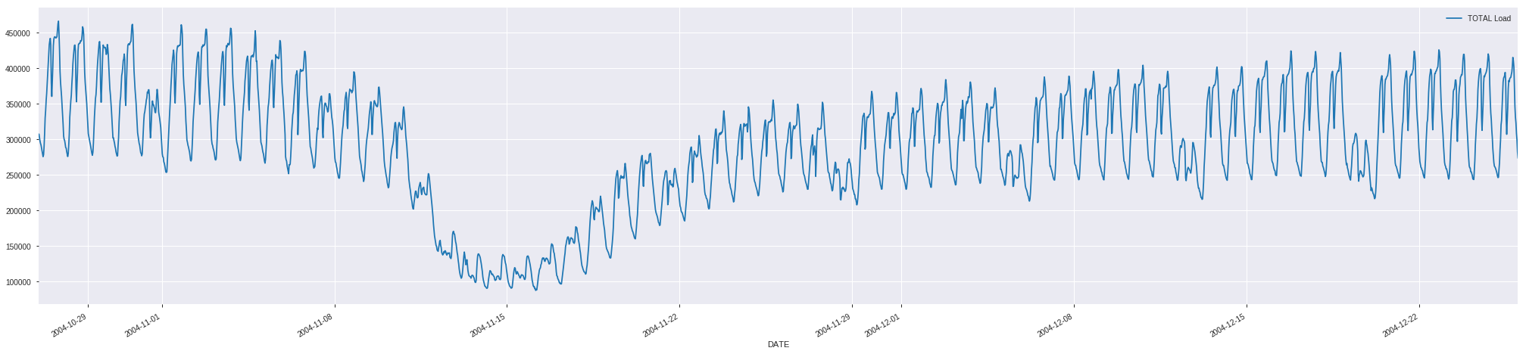
1 year’s Power Consumption
Expanded view of the decreasing curve

Slide 8
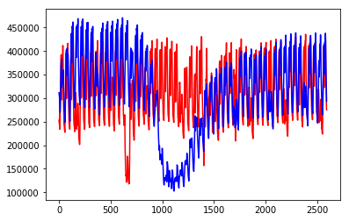
Approach and Building Model
SARIMA adds three new hyperparameters to specify the autoregression (AR), differencing (I) and moving average (MA) for the seasonal component of the series, as well as an additional parameter for the period of the seasonality. The MAPE obtained for the validation dataset is 28.

Slide 9
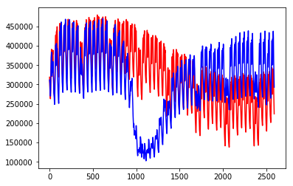
Approach and Building Model
Prophet is a procedure for forecasting time series data based on an additive model where non-linear trends are fit with yearly, weekly, and daily seasonality, plus holiday effects. It works best with time series that have strong seasonal effects and several seasons of historical data.
The training MAPE for the dataset is 10 while the validation MAPE is 32.

Slide 10
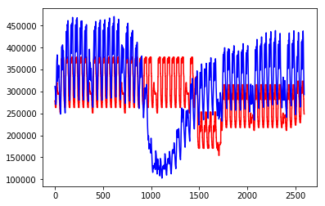
Approach and Building Model
XGBoost, a Gradient Boosted tree algorithm can be used for the forecasting problems.
The testing MAPE observed is 32.

Slide 11
Conclusion
Since the energy consumption is low on holidays, the energy corporation should generate less power for those days.
The dip in the graph is not getting detected by the model as the dataset is for only 3 years, so the drop in the energy consumption occurs only three times in the respective two years which is very less compared to the granularity of data i.e. for 30 minute intervals.
The dip in the graph probably represents a season change since there is a sharp decrease in the power consumption. The corporation can limit the generation of power during that period.
The training MAPE for the dataset is 10 while the validation MAPE is 32 for prophet, 28 for SARIMA model.

Slide 12
Day of the year was most commonly used to split trees, while hour and year came in next thus stating their respective importance.
The forecasted energy demand values can be used to optimize the power generation process thus decreasing wastage and increasing the profits of the corporation.
The SARIMA model has given the closest forecasted values and will also prove to be effective in the production environment.

Slide 13
THANK YOU

